Slide 1


Doppelgänger
** A doppelgänger is a biologically unrelated look-alike, or a double, of a real person.
Synthetic Data Generator
PRS Group 19 – Anirban, Taksh, Prashant, Nirav

Slide 2
Data is the new GOLD!
Back in 2017, The Economist published a story titled, "The world's most valuable resource is no longer oil, but data." In today’s data-driven machine learning world, data is the new gold!
Machine Learning requires a lot of training data. However there are two significant concerns about data:
Data Quantity
Good quality data is time-consuming & expensive to collect in the quantities required for ML.
Collected data is often unbalanced on the target class that could lead to a bias in the ML.
Data Privacy
Real world data comes with significant privacy concerns about PII (Personally Identifiable Info)
Simple technique like data masking & obfuscation are not always effective
Introducing Doppelgänger – the Synthetic Data Generator
creates synthetic data that matches the important statistical properties of the real data set.
used to generating additional synthetic training data for the under-represented class or
preserving the privacy of the real data by changing the specific values.

Slide 3
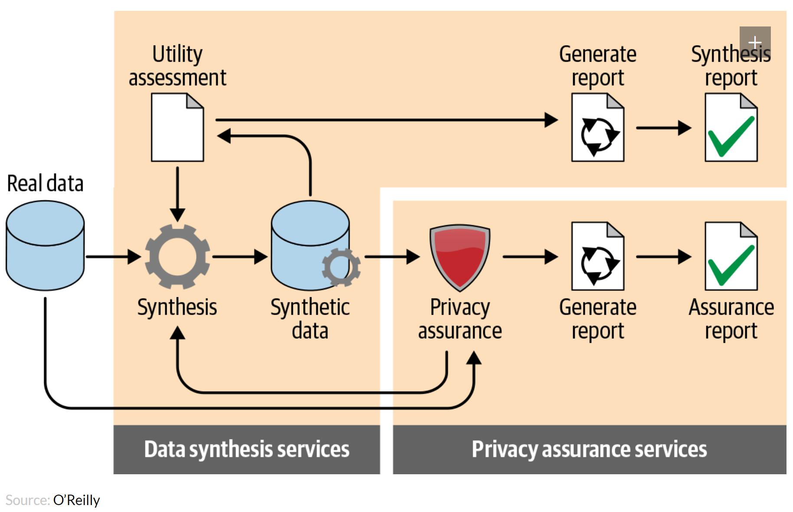
Solution Architecture

Slide 4
Data Owner
Data Generator
Data Buyer
Doppelgänger
Solution
Architecture
Synthetic Data Evaluator
Train Error
Synthetic Data Certification
Test Error
Test
Train
Real Data
Train
Real Data
Test
Validated
Synthetic Data
Real Data
Train
Real Data
Test
Validated Synthetic Data
This is actually 3Data split: Split the real data into R-Test & R-Train data
R-Test: Will be used to generate the Synthetic Data
R-Train: Will be used to evaluate the Synthetic Data
(9)
This is actually 3Data split: Split the real data into R-Test & R-Train data
R-Test: Will be used to generate the Synthetic Data
R-Train: Will be used to evaluate the Synthetic Data
(10)
Feed the SynData into this trained validator and ask it to classify the input.
If the validator is able to classify the synthetic data correctly, then it passes the test and is accepted as ‘good’ synthetic data.
Else it is discarded. (6)
This is actually 3Data split: Split the real data into R-Test & R-Train data
R-Test: Will be used to generate the Synthetic Data
R-Train: Will be used to evaluate the Synthetic Data
(8)
Apply inverse_transform() on the trained extractor model to generate synthetic data. Suitable noise should be added to the generator.
This can be achieved by reducing the dimensionality (eg use a smaller number of PCA to inverse) or adding some noise into the latent space (eg VAE) (4)
Use R-Test to train the Synthetic Data Generator.
Extractor: Fit a suitable ML model to the real data. The underlying data patterns will be encoded within the trainable parameters.
Models like VAE with a structured latent space is well suited for this purpose. (3)
This is actually 3Data split: Split the real data into R-Test & R-Train data
R-Test: Will be used to generate the Synthetic Data
R-Train: Will be used to evaluate the Synthetic Data
(7)
This is actually 3Data split: Split the real data into R-Test & R-Train data
R-Test: Will be used to generate the Synthetic Data
R-Train: Will be used to evaluate the Synthetic Data
(11)
Validator: Validates the generated synthetic data to filter our rows that do are too far from the real data patterns.
This is done by fitting a suitable classifier model on the real-data (5)
Data Owner: Owner of the real data that is willing but has sensitivities sharing the data
Data Generator: This is entity/product that will provide the services to generate the synthetic data ie Doppelgänger
Data Buyer: Persons interested in acquiring this synthetic data to train their models. (1)
Data split: Split the real data into R-Test & R-Train data
R-Test: Will be used to generate the Synthetic Data
R-Train: Will be used to evaluate the Synthetic Data (2)
Data Pattern Encoder
Synthetic Data
Validator
Data Pattern Extractor
Raw
Synthetic Data

Slide 5
Addressing Real-World Problems …
Doppelgänger can address different types of business problems –
• Multiple types of input data - Numeric, Time-series, Image, Textual or Mixed input data
• Different problem types - Regression problems, Classification problems
• Address various concerns - Data privacy & sensitivity, balancing target variable classes
• Cost-effective– Easier to generate when real data availability is limited or is too expensive
Some current real-world use cases where this can be used -
• Safe-Entry (Privacy Concerns) - is already useful in COVID-19 contact tracing, but due to privacy laws, raw data cannot be shared with other businesses. However, synthetic data generated from Safe-Entry can be as much helpful without privacy concerns.
• Fraud Detection (Data Balancing issues) - Fraud transactions by nature are far fewer than the valid ones, synthetic data can compliment actual data to make input dataset balanced. Scenario based data can be generated to train different categories of frauds.

Slide 6
Case Study 1 - Predicting Life Expectancy (WHO)
Problem is related to life expectancy & health factors for 193 countries covering demographic variables, income composition, mortality rates, immunization and human development index.
Data sensitivity concerns are due to Personally Identifiable Health Information (PIHI), Economical and Social factors.
Problem Attributes
Numeric Regression Problem
Data Sensitivity & Privacy issue
Regression Strategies | Large Datasets (>50K) | Smaller Datasets (<50K)
Generator | . Variational Autoencoder (VAE) | . Use inverse transform PCA
Validator | . Artificial Neural Networks (ANN) . Autoencoder (AE) | . Linear Regression . Random Forest . XGBoost
Evaluator | . Artificial Neural Networks (ANN) | . Linear Regression
Implementation
Select attributes with privacy concerns
Run PCA to reduce features to n-dimensions
Generate: Inverse transform with < n PCAs
Validate: with XGB fitted on the real data
Evaluate: Use LR to compare prediction error between synthetic and real data
* Final dataset has 22 columns and 3K rows which meant 20 predicting variables.
* We are using the models marked in red

Slide 7
Case Study 2 - Data Augmentation of Medical Images
Problem is related to the unbalanced data since the number of real patient images with positive diagnosis is very small, Doppelgänger can be used to generate synthetic positive data based to balance dataset and reduce bias.
Problem Attributes
Image Classification problem
Balancing target variable classes
Classification Strategies | Large Datasets (>50K) | Smaller Datasets (<50K)
Generator | . Variational Autoencoder (VAE) | Use inverse transform PCA NMF
Validator | . Convolutional Neural Networks (CNN) . Autoencoder (AE) | . XGBoost . Random Forest . ANN
Evaluator | . Convolutional Neural Networks (CNN) | . Convolutional Neural Networks (CNN)
Implementation
Select rows from the minority classes
Fit the VAE encoder to select real data
Generate: Add noise to latent space and generate new synthetic images
Validate: with CNN fitted on the real data
Evaluate: Use CNN to compare prediction error between synthetic and real data
* We are using the models marked in red

Slide 8
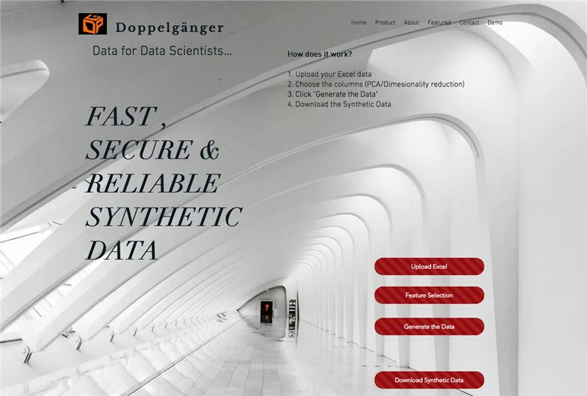
Doppelgänger Web Interface
• Rich Internet Application
Python
Flask
HTML

Slide 9
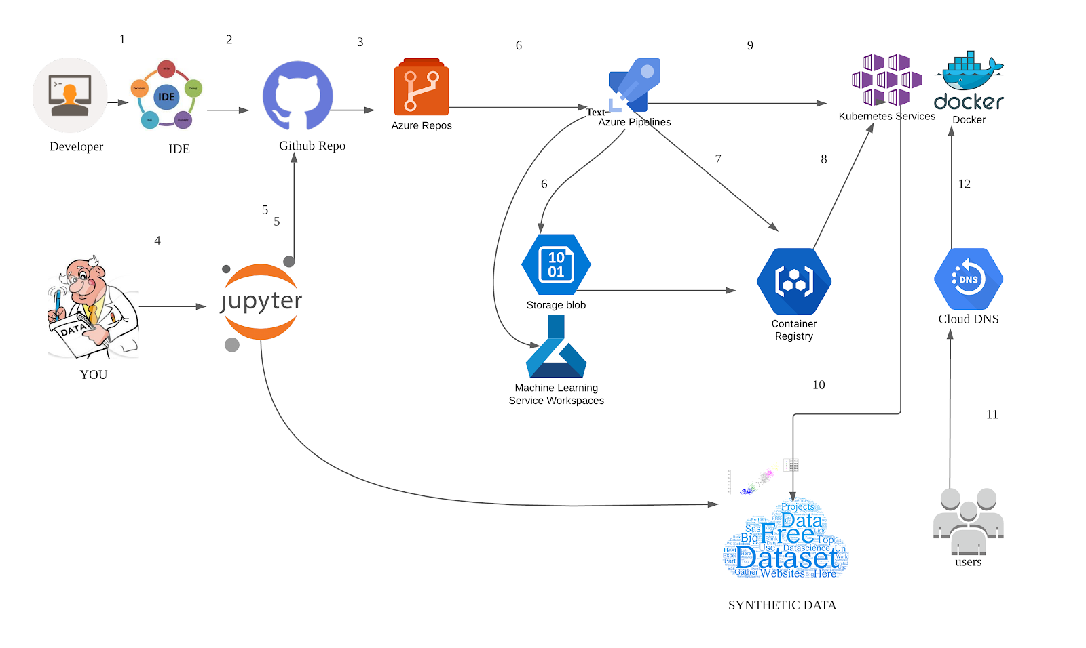
Deployment Architecture – MLOps
Data Generator – Dev Team
Data Generator – Prod Deployment
Data Owner
Data Buyer

Slide 10
The Doppelgänger Team
Thank you..!

